Slide 1
Day 2 Afternoon:
Experiment Design
Prof. Shengdong Zhao

Slide 2
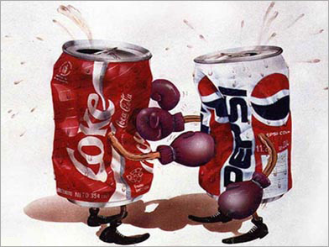
Pepsi vs Coke

Slide 3
Pepsi vs Coke
Pepsi ran a taste test to see if people like the taste of Pepsi better than the taste of Coke.
They randomly selected 100 participants for the test.
Participants sat at a table, with two cups in front of them, one with Pepsi labeled ‘M’, and one with Coke labeled ‘Q’. Half the participants first tried the ‘M’ cup and then the ‘Q’ cup, and the other half of the participants tasted the drinks in opposite orders.
Participants were then asked which cup had the drink that they preferred.
65% of the participants indicated they liked the cup that had Pepsi better.
The researchers conclude that people like the taste of Pepsi better.

Slide 4
Is the result of the Coke vs Pepsi experiment trustworthy? If not, why?
PollEv.com/szhao168 Q4

Slide 5
Pepsi vs Coke
In another experiment, 60 subjects were asked to drink cola from two cups one marked “L” and one marked “S” and they overwhelmingly preferred the “S” cup even though both contained the same product.
In another experiment, 30 subjects were asked their preference for Pepsi or Coke, but in this case they drank Pepsi from a Coke bottle and vice versa.
They found that subjects were significantly influenced by the label of the product that they preferred and not by the taste differences.

Slide 6
Outline
The five step approach to Experiment Design (5 steps)
Define the research question
Determine variables
Arrange conditions
Decide blocks and trials
Set instruction and procedures

Slide 7

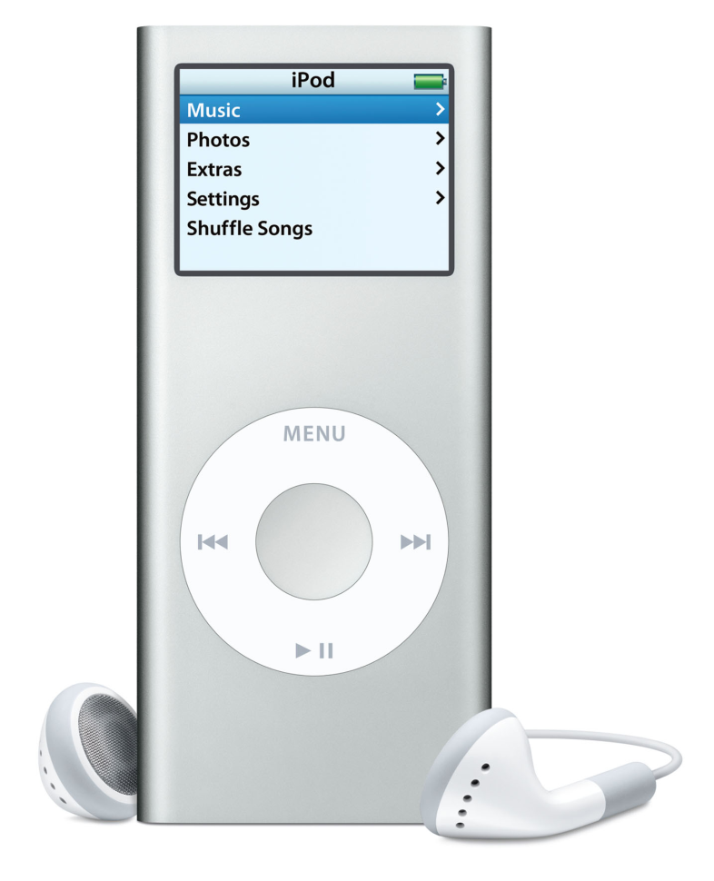
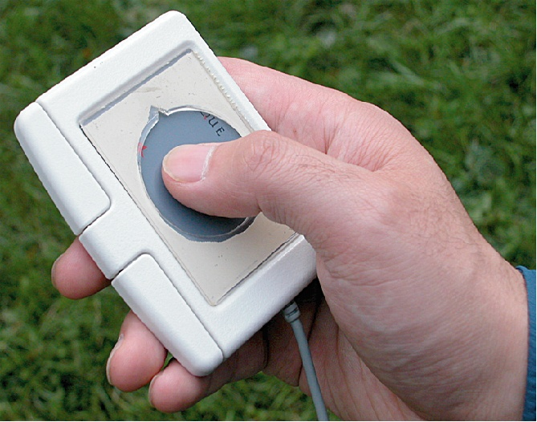
Let’s Start with an Example
earPod vs. iPod

Slide 8
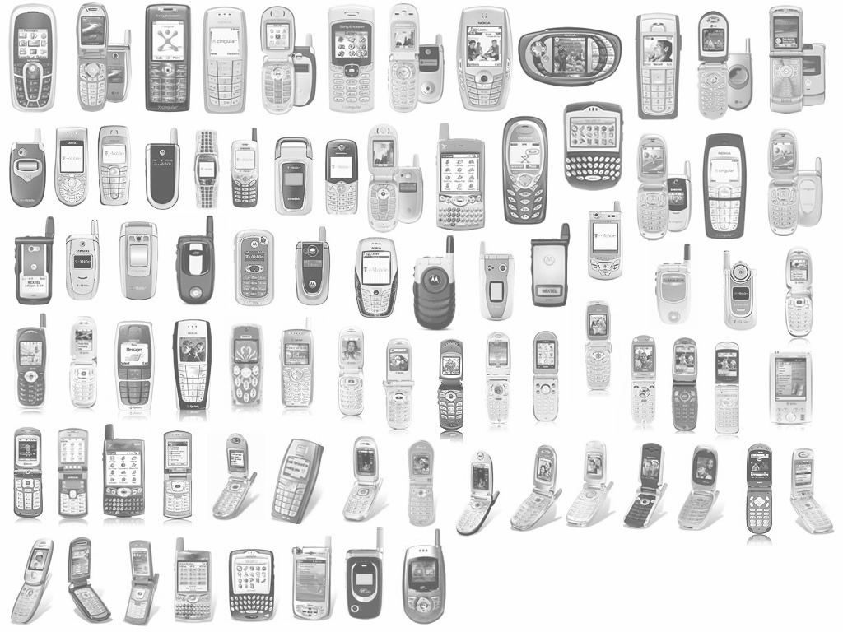
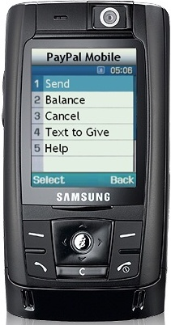
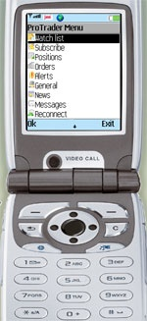
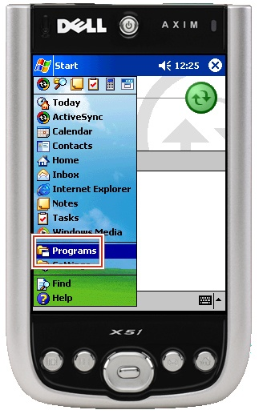

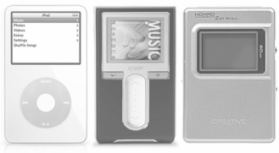




‹#›
Notes:
‹#›
Most of these mobile devices allow the users to use its rich features through a hierarchical menu

Slide 9


Menu Selection
on
Mobile Devices
Often Requires
Visual Feedback
‹#›
Notes:
‹#›
However, almost all of them requires visual attention to operate. In mobile scenarios, visual attention or feedback is not always desirable or feasible due to a number of reasons.

Slide 10


Why Eyes-free?
‹#›
Notes:
‹#›
For example, to reduce the device form factor, and increase portability, or to reduce the cost, or save battery life, some mobile devices are build without a visual display.

Slide 11
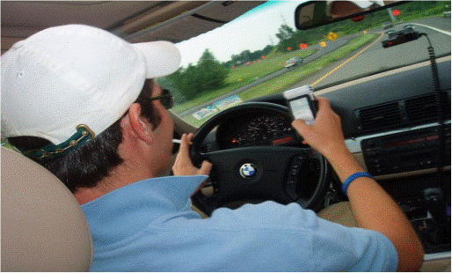

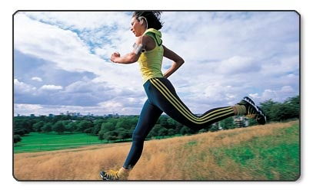
Why Eyes-free?
‹#›
Notes:
‹#›
When you are in the mobile scenarios, such as walking, running, or driving, you need to pay attention to the environment, looking at the interface might be disruptive or even dangerous.

Slide 12
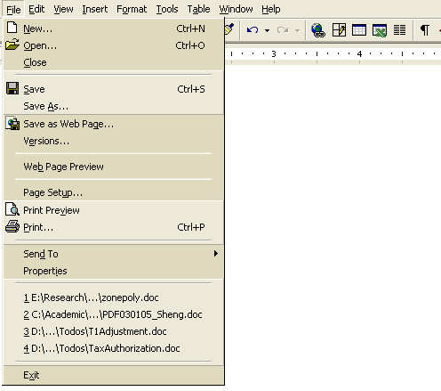
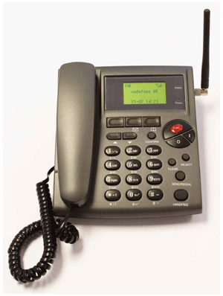

Visual vs. auditory menu
Visual Linear Menu
IVR System
‹#›
Notes:
‹#›
Here is an IVR style menu. Please pay attention to how long it takes. Well it takes full 20 seconds, and it only has 4 to 5 options.
It uses an imposed rate of presentation and user can’t scan and compare, so people have to rely on their short-term memory. The presentation rate will often be either too slow (e.g., when information is irrelevant) or too fast (e.g., when information is critical) for the user. No wonder they are called the “Touchtone Hell”.
using audio to convey a list of choices requires users to adapt to an imposed rate of presentation and rely on their short-term memory. The presentation rate will often be either too slow (e.g., when information is irrelevant) or too fast (e.g., when information is critical) for the user.

Slide 13
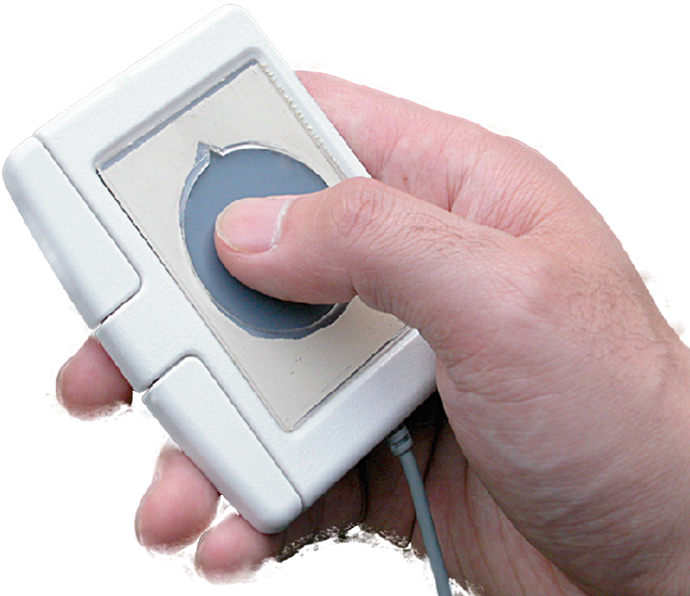
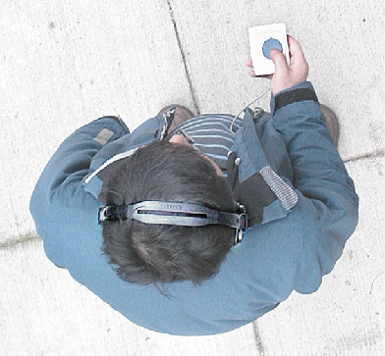
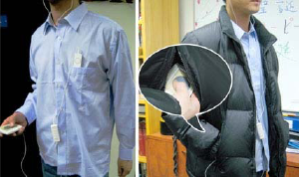
earPod
‹#›
Notes:
‹#›
earPod uses a round touchpad as it’s input device which can be comfortably hold in hand, and it’s light weight and portable, so it can be used even inside the pocket.

Slide 14
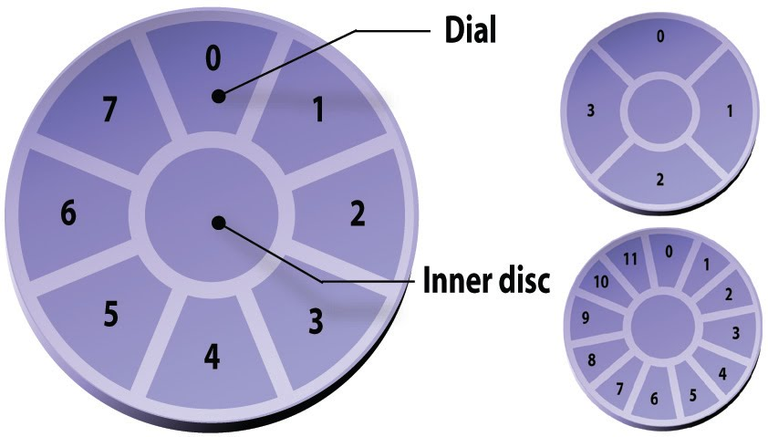
earPod design
‹#›
Notes:
‹#›
This area is divided into two zones. The outer zone is the dial which can be divided into many subsections, and each subsection will be mapped to particular menu item. The inner disc is reserved for specific functions such as canceling a selection. According to the previous studies in various marking menu settings. Commonly, we can divide the outer disk or the dial into 4, 8, or 12 subsections to allow best performance, which is the breadth of a menu.

Slide 15
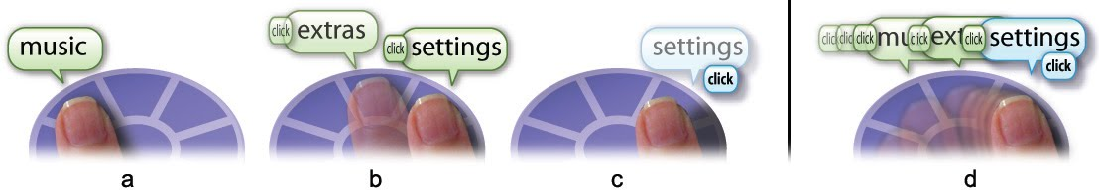
earPod walkthrough
Notes:
‹#›
User can explore the items by gliding the thumb along the raised edge of the circular cutout. As user’s thumb moves into a section, a spatialized audio message will be played, for example, if the user’s thumb is on the right-most item, the audio message will be played as if the sound comes from the right side. When the finger moves from one section to the other, a non-speech clicking sound will be played to indicate boundary crossing. User can keep browsing as long as the finger stay in contact the touchpad, and once they found the item, release the thumb will select it.

Slide 16
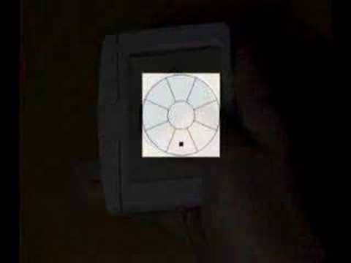
Video of Earpod use
Notes:
‹#›
Now we have an overview of the system, let me tell you the story behind its design. The technique seems to be fairly simple, but it actually takes a lot of efforts. I had the idea on eyes-free menu selection about 4 years ago, and it’s not until last year, we finally found a solution we felt pretty good about and build the earPod prototype. To understand the difficult behind earPod design, let’s look at a somewhat similar technique

Slide 17
Fast browsing
Notes:
‹#›
As the user is getting more familiar with the menu structure, they can browse faster, and the audio messages will be slightly cut off, but there is still enough information for the user to determine if the item is the desirable one or not.

Slide 18
Very fast browsing and cancel
Notes:
‹#›
As the user becoming more familiar with the system, even a very short audio cue will provide enough information for them to keep or discard the item, and the browsing can be very fast. If the user wants to cancel the selection, they can drag the finger into the middle circle, and release from there will cancel the selection.

Slide 19
Expert use
Notes:
‹#›
Finally, once the user becomes very familiar with the menu layout and remember the physical location of a particular item, they can select it just like pressing a button.

Slide 20
The five step approach to Experiment Design
Define the Research Question.
Determine the variables.
Arrange Conditionals.
Decide blocks and trials.
Set instructions and procedures.

Slide 21
Define the Research Question
Start with a general question
Define target population
Define task(s)
Define measure(s)
Define other factor(s)

Slide 22
Start with General Question
General Question: How does Earpod compare with ipod’s menu in terms of performance?
Notes:
Talk about the scientific method

Slide 23
Define the Target Population
General Question: How does Earpod compare with ipod’s menu in terms of performance?
Target Population: Who do we design the earpod for? Young people.

Slide 24
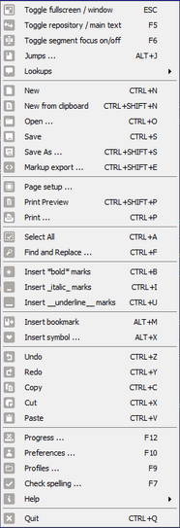
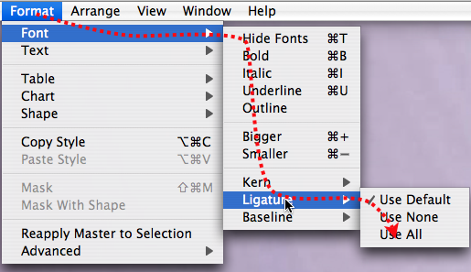
Define Task(s)
General Question: How does Earpod compare with ipod’s menu in terms of performance?
Tasks: Menu selection However, the task of menu selection has a lot of possibilities: single short menu, single long menu, hierarchical menus.

Slide 25
Define Task(s)
Key insight: the experimental design needs to decide what subset of task is appropriate to test.
Question: How do you choose the subset? What type of menus should we do our tasks on?
Pollev.com/szhao168
Q5

Slide 26
Define Measures
General Question: How does Earpod compare with ipod’s menu in terms of performance?
Measures: Performance
In HCI three main measures are used to quantify performance
Speed
Accuracy
Learnability
Key insight: Need to define testable measures.

Slide 27
Define other factors
General Question: How does Earpod compare with ipod’s menu in terms of performance?
Other Factors: Other than the different type of tasks, what other factors can influence the measures?
Again, the number of factors can be unlimited:
Scenario of use
Input Device
Background of the user

Slide 28
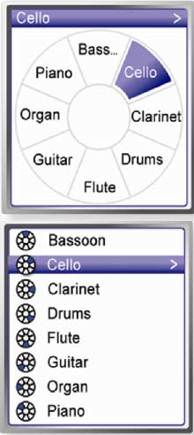
Earpod vs iPod
General Question: How does Earpod compare with ipod’s menu in terms of performance?
Target Population: Who do we design the earpod for? Young people.
Task(s): Menu selection for three types of breadth(4,8,12) and two types of depth(1,2).
Measures: Speed, accuracy and learning.
Other factors: Single task vs multitasking etc.

Slide 29
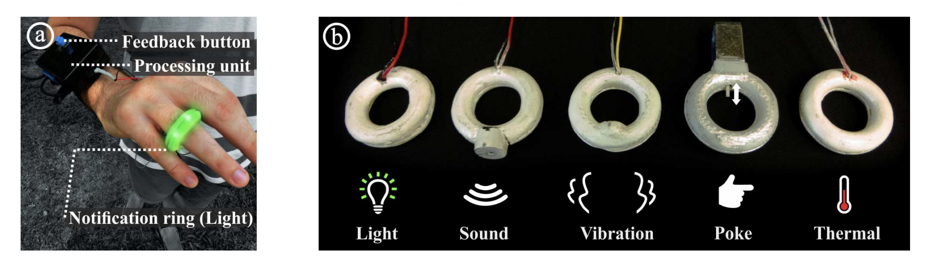
Example 2 : Wearable interactive rings
Wearable interactive rings brings new opportunities for notification design.
There are five types of ring that offer notification.
Four provide with instant feedback (light, sound ,vibration and poke) one provide a thermal channel with gradually increasing temperature.

Slide 30
Example 2: Wearable interactive rings
General Question: Which ring is more effective at delivering timely notification.

Slide 31
Example 2: Wearable interactive rings
General Question: Which ring is more effective at delivering timely notification.
Target Population: Anyone using Technology.

Slide 32
Example 2: Wearable interactive rings
General Question: Which ring is more effective at delivering timely notification.
Target Population: Anyone using Technology
Tasks: Simple on and off notification task.

Slide 33
Example 2: Wearable interactive rings
General Question: Which ring is more effective at delivering timely notification.
Target Population: Anyone using Technology
Tasks: Simple on and off notification task.
But in this case level of activity might play an important role in receiving notifications! Maybe we can incorporate this as a part of the task.

Slide 34
Example 2: Wearable interactive rings
General Question: Which ring is more effective at delivering timely notification.
Target Population: Anyone using Technology
Tasks: Simple on and off notification task during five levels of physical activity(lying, sitting, standing, walking, running etc)

Slide 35
What can be an appropriate measure to compare the effectiveness of rings?
PollEv.com/szhao168

Slide 36
Example 2: Wearable interactive rings
General Question: Which ring is more effective at delivering timely notification.
Target Population: Anyone using Technology
Tasks: Simple on and off notification task during five levels of physical activity(lying, sitting, standing, walking, running etc)
Measures:
Reaction Time (from presentation of the stimuli on the ring to the participants hitting the button),
Error rate (percentage of time they did not perceive notifications out of all notifications).
Other Factors: Hot vs Cold day etc.

Slide 37

Example 2 : NotiRing

Slide 38
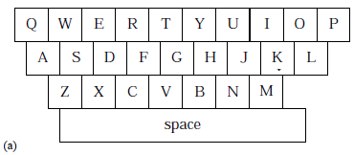
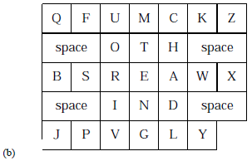
Example 3: Opti vs Qwerty keyboard

Slide 39
Example 3: Opti vs Qwerty keyboard
General question: How does the “opti” keyboard layout compare with the “qwerty” keyboard layout in terms of performance?
Target Population: Computer Users

Slide 40
Example 3: Opti vs Qwerty keyboard
General question: How does the “opti” keyboard layout compare with the “qwerty” keyboard layout in terms of performance?
Target Population: Computer Users
What would be an appropriate task and measure for this question?
PollEv.com/szhao168

Slide 41
Example 3: Opti vs Qwerty keyboard
General question: How does the “opti” keyboard layout compare with the “qwerty” keyboard layout in terms of performance?
Target Population: Computer Users
Tasks: Type “quick brown fox jumps over the lazy dog”
Measures: Speed , accuracy
Other factors: Touch vs Stylus etc.

Slide 42
STEP2
Determine Variables
Notes:
Instructions and Procedures are crucial to the real conduction of experiments.

Slide 43
Types of Variables
Independent variable (IV)
Factors that are manipulated in the experiment
Have multiple levels
Dependent variable (DV)
Factors which are measured
Control variable
Attributes that will be fixed throughout experiment
Confound – attribute that varied and was not accounted for
Random variable
Attributes that are randomly sampled
Increases generalizability

Slide 44
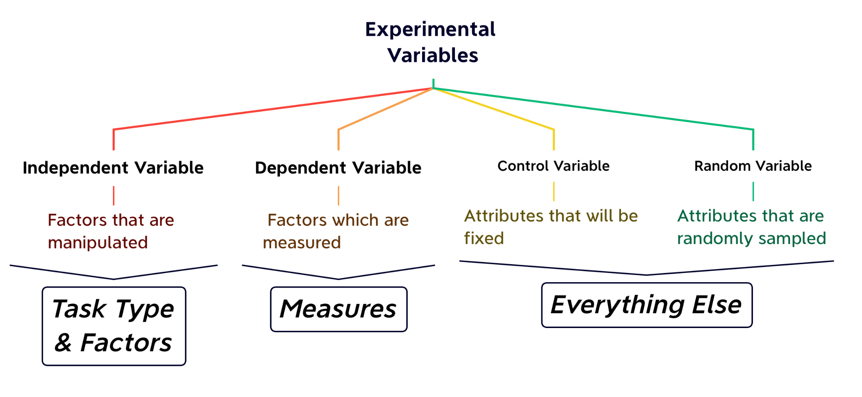

Slide 47
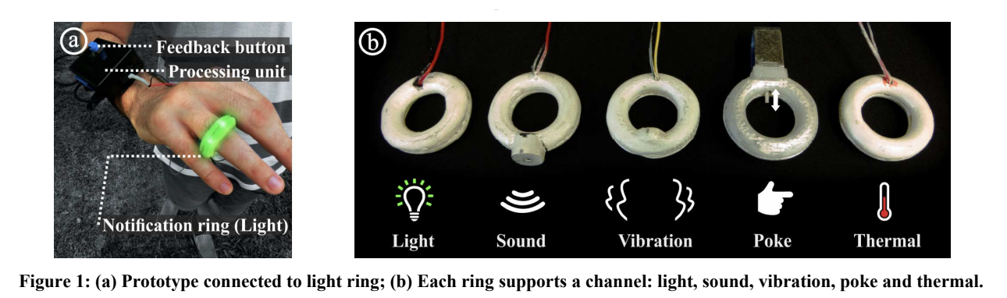
Example 1
Independent Variables
channel (light, sound, vibration,poke, thermal)
activity level (lying down, sitting, standing, walking, running)
Dependent Variables
reaction time (from presentation of the stimuli on the ring to the participants hitting the button)
error rate (percentage of time they did not perceive notifications out of all notifications)
Control Variables
environment, ring texture, experiment time, etc.
Random Variables
Attributes of participants: age, gender, background, etc.

Slide 48

Confounding Variables
Definition: Any variable other than the independent variables that can possibly explain the change in measures
Example 1: Two search engine interfaces are compared (Google vs. new)
What are the possible problems?

Slide 49
Confounding Variables
Definition: Any variable other than the independent variables that can possibly explain the change in measures
Example 1: Two search engine interfaces are compared (Google vs. new)
All participants have prior experience with Google, but no experience with the new interface.
“Prior experience” is a confounding variable

Slide 50
Confounding Variables
Definition: Any variable other than the independent variables that can possibly explain the change in measures
Example 2: Three techniques are compared (A, B, C). All participants are tested on A, followed by B, followed by C.

Slide 51
Confounding Variables
Definition: Any variable other than the independent variables that can possibly explain the change in measures
Example 2: Three techniques are compared (A, B, C). All participants are tested on A, followed by B, followed by C.
Performance might improve due to practice.
“Practice” is a confounding variable (because it explains the changes in measures but it is not an IV)

Slide 52
Confounding Variables
Definition: Any variable other than the independent variables that can possibly explain the change in measures
Practice & Prior experience are two important confounding variables we need to control.
Question: How to control these confounding variables?

Slide 53
STEP3
Arrange Conditions
Notes:
Instructions and Procedures are crucial to the real conduction of experiments.

Slide 54
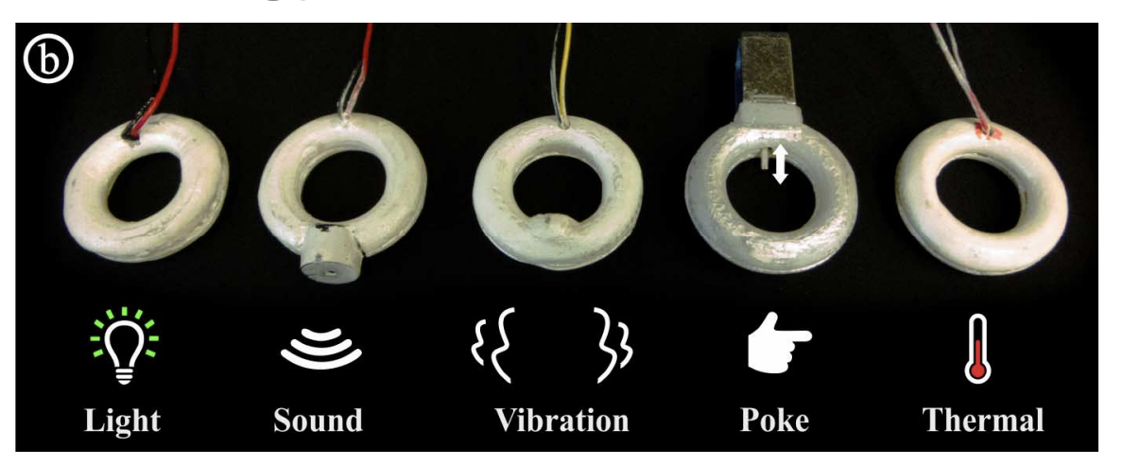
What is Condition? Take an Example!
An independent variable “Notification Channel” has 5 levels:
(Light, Sound, Vibration, Poke, Thermal)
If it is the only independent variable considered, this experiment has 5 conditions
Suppose there is another independent variable “Ring Size” with 3 levels:
(4 mm, 8 mm, 12 mm)
There are 5 (Notification Channel) x 3 (Ring Size) = 15 conditions
The each unique combination of the different levels of the various independent variables is an experimental condition

Slide 55
How to test those 15 conditions?
Method 1: Between-Subject Design
Recruit 15 participants, one for each condition.
P1: (Light, 4mm)
P2: (Light, 8mm)
…
P15: (Thermal, 12mm)

Slide 56
How to test those 5 conditions?
Method 1: Between-Subject Design
Recruit 5 participants, one for each level for “Notification Type” .
P1: (Light)
P2: (Sound)
P3: (Vibration)
P4: (Poke)
P5: (Thermal)
Any problem?

Slide 57
How to test those 15 conditions?
Method 1: Between-Subject Design
Recruit 5 participants, one for each level for “Notification Type” .
P1: (Light)
P2: (Sound)
P3: (Vibration)
P4: (Poke)
P5: (Thermal)
Any problem?
Individual Difference → Recruit more participants

Slide 58
How to test those 15 conditions?
Method 1: Between-Subject Design
Recruit 5 participants, one for each level for “Notification Type” .
P1: (Light)
P2: (Sound)
P3: (Vibration)
P4: (Poke)
P5: (Thermal)
Any problem?
Individual Difference → Recruit more participants
Problem of Method 1:
Expensive

Slide 59
How to test those 15 conditions?
Method 2: Within-Subject Design
Recruit 1 participants for all the 5 conditions.
P1: (Light), (Sound), … , (Thermal)

Slide 60
How to test those 15 conditions?
Method 2: Within-Subject Design
Recruit “N” participants account for generalizability.
P1: (Light), (Sound), … , (Thermal)
P2: (Light), (Sound), … , (Thermal)
…
PN: (Light), (Sound), … , (Thermal)
Problem of Method 2:

Slide 61
How to test those 15 conditions?
Method 2: Within-Subject Design
Recruit “N” participants account for individual differences and generalizability.
P1: (Light), (Sound), … , (Thermal)
P2: (Light), (Sound), … , (Thermal)
…
PN: (Light), (Sound), … , (Thermal)
Problem of Method 2:
Confounding Variable: Practice / Order Effect

Slide 62
How to deal with the Order Effect?
Assumption: The order effect is (i) symmetric, which means A → B = B → A, and (ii) linear, which means the increment between different conditions is the same.
We can use Counter-Balancing to cancel the effect out :)
Example: assume the transferring effect between (A after B) and (B after A) are both 10
Participant 1: A followed by B (A B)
Participant 2: B followed by A (B A)

Slide 63
How to deal with the Order Effect?
Assumption: The order effect is (i) symmetric, which means A → B = B → A, and (ii) linear, which means the increment between different conditions is the same.
We can use Counter-Balancing to cancel the effect out :)
Example: assume the transferring effect between (A after B) and (B after A) are both 10
Participant 1: A followed by B (A B)
Participant 2: B followed by A (B A)
 | Effect of A | Effect of B
P1 (A B) | a | b+10
P2 (B A) | a+10 | b
Average | a+5 | b+5

Slide 64
How to deal with the Order Effect?
Assumption: The order effect is (i) symmetric, which means A → B = B → A, and (ii) linear, which means the increment between different conditions is the same.
We can use Counter-Balancing to cancel the effect out :)
Example: assume the transferring effect between (A after B) and (B after A) are both 10
Participant 1: A followed by B (A B)
Participant 2: B followed by A (B A)
 | Effect of A | Effect of B
P1 (A B) | a | b+10
P2 (B A) | a+10 | b
Average | a+5 | b+5
The absolute relationship won’t be changed

Slide 65
How to deal with the Order Effect?
Assumption: The order effect is (i) symmetric, which means A → B = B → A, and (ii) linear, which means the increment between different conditions is the same.
We can use Counter-Balancing to cancel the effect out :)
Example: assume the transferring effect between (A after B) and (B after A) are the same
Participant 1: A followed by B (A B)
Participant 2: B followed by A (B A)
However, still need a minimum number of participants.

Slide 66
Counter-Balancing with More Levels
An independent variable with 3 Levels: A, B, C,
P1: A B C
P2: A C B
P3: B A C
P4: B C A
P5: C A B
P6: C B A
4 Levels: 4! = 24 counter-balances
5 Levels: 5! = 120 counter-balances

Slide 67
Partial Counter-Balancing: Latin Square
Latin Square
We ensure each level appears in every position in order equally often:
P1: A B C
P2: B C A
P3: C A B

Slide 68
Partial Counter-Balancing: Latin Square
Latin Square
Ensures each level appears in every position in order equally often:
P1: A B C
P2: B C A
P3: C A B
 | Effect of A | Effect of B | Effect of C
P1 (A B C) | a | b+10 | c+20
P2 (B C A) | a+20 | b | c+10
P3 (C A B) | a+10 | b+20 | c
Average | a+10 | b+10 | c+10
The absolute relationship won’t be changed

Slide 69
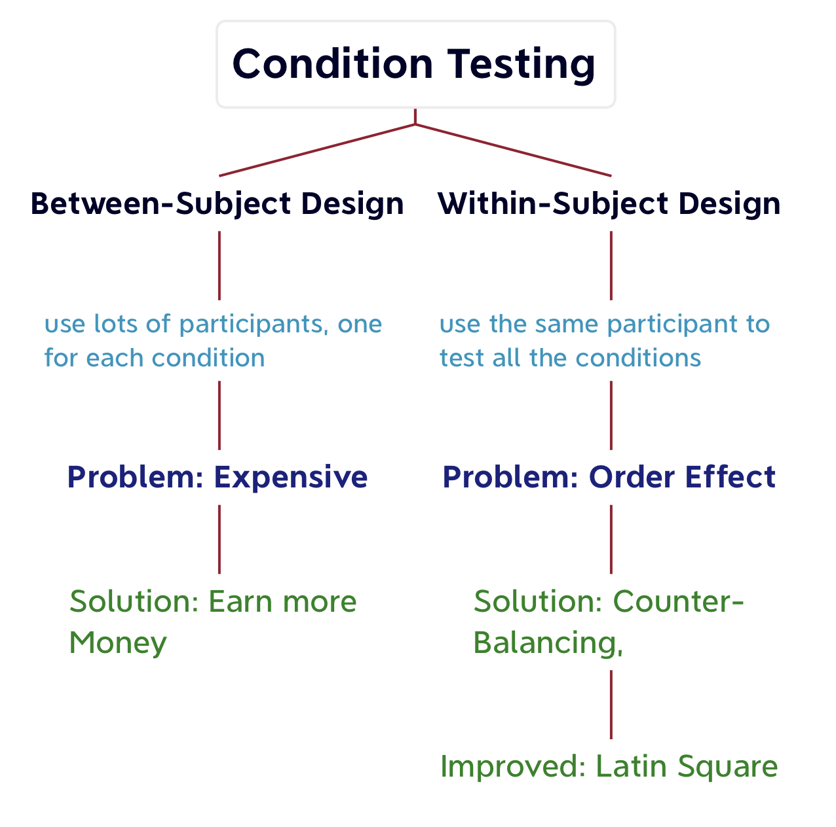

Slide 70
Pipeline of Arranging Conditions for Within-Subject Design
3.1: List all Independent Variables and their levels
3.2: Decide counter-balancing strategy for each variable
3.3: Determine the minimum No. of participants
3.4: Arrange the overall design
3.5: Determine detailed arrangement for each participant

Slide 71
Pipeline of Arranging Conditions for Within-Subject Design
3.1: List all Independent Variables and their levels
3.2: Decide counter-balancing strategy for each variable
3.3: Determine the minimum No. of participants
3.4: Arrange the overall design
3.5: Determine detailed arrangement for each participant
(How about between-subject design?)

Slide 72
Pipeline of Arranging Conditions for Within-Subject Design
3.1: List all Independent Variables and their levels
3.2: Decide counter-balancing strategy for each variable
3.3: Determine the minimum No. of participants
3.4: Arrange the overall design
3.5: Determine detailed arrangement for each participant
(How about between-subject design?)

Slide 73
Example 1: Notification Channels for Wearable Ring
3.1: List all Independent Variables and their levels
Channel. 5 levels: (light, sound, vibration, poke, thermal)
Activity Level. 5 levels: (lying down, sitting, standing, walking, running)
3.2: Decide counter-balancing strategy for each variable
Choices: (i) Fully Counter-Balancing, (ii) Latin Square, (iii) No Counter-Balancing
Notes:
This part needs a bit of introduction.
Use fully counter-balancing when it is possible. However, most of the time, Latin-square will be sufficient.
No counter-balancing can be used if we are not interested in knowing the absolute relationship between the different levels of an independent variable, but we are more interested to see if the results of another IV can be generalized to the different levels, and found out the rough trend in relationship with the primary IV.
Remember to provide an example here.

Slide 74
Example 1: Notification Channels for Wearable Ring
3.1: List all Independent Variables and their levels
Channel. 5 levels: (light, sound, vibration, poke, thermal)
Activity Level. 5 levels: (lying down, sitting, standing, walking, running)
3.2: Decide counter-balancing strategy for each variable
Choices: (i) Fully Counter-Balancing, (ii) Latin Square, (iii) No Counter-Balancing
How to decide the strategy?
How interesting is the independent variable?
How much resource do we have?
Notes:
This part needs a bit of introduction.
Use fully counter-balancing when it is possible. However, most of the time, Latin-square will be sufficient.
No counter-balancing can be used if we are not interested in knowing the absolute relationship between the different levels of an independent variable, but we are more interested to see if the results of another IV can be generalized to the different levels, and found out the rough trend in relationship with the primary IV.
Remember to provide an example here.

Slide 75
Example 1: Notification Channels for Wearable Ring
3.2: Decide counter-balancing strategy for each variable
Channel: Latin Square
Activity Level: Latin Square
3.3: Determine the minimum No. of participants
Min. No. = 5 (5 Channel levels) * 5 (5 Activity levels)
Notes:
This part needs a bit of introduction.
Use fully counter-balancing when it is possible. However, most of the time, Latin-square will be sufficient.
No counter-balancing can be used if we are not interested in knowing the absolute relationship between the different levels of an independent variable, but we are more interested to see if the results of another IV can be generalized to the different levels, and found out the rough trend in relationship with the primary IV.
Remember to provide an example here.

Slide 76
Example 1: Notification Channels for Wearable Ring
3.2: Decide counter-balancing strategy for each variable
Channel: Latin Square
Activity Level: Latin Square
3.3: Determine the minimum No. of participants
Min. No. = 5 (5 Channel levels) * 5 (5 Activity levels)
Question: What if we choose fully counter-balancing for Channel and Activity Level?
PollEv.com/szhao168
Notes:
This part needs a bit of introduction.
Use fully counter-balancing when it is possible. However, most of the time, Latin-square will be sufficient.
No counter-balancing can be used if we are not interested in knowing the absolute relationship between the different levels of an independent variable, but we are more interested to see if the results of another IV can be generalized to the different levels, and found out the rough trend in relationship with the primary IV.
Remember to provide an example here.

Slide 77
Example 1: Notification Channels for Wearable Ring
3.2: Decide counter-balancing strategy for each variable
Channel: Latin Square
Activity Level: Latin Square
3.3: Determine the minimum No. of participants
Min. No. = 5 (5 Channel levels) * 5 (5 Activity levels) = 25
Question: What if we choose fully counter-balancing for Channel and Activity Level?
5! * 5! = 14,400
Notes:
This part needs a bit of introduction.
Use fully counter-balancing when it is possible. However, most of the time, Latin-square will be sufficient.
No counter-balancing can be used if we are not interested in knowing the absolute relationship between the different levels of an independent variable, but we are more interested to see if the results of another IV can be generalized to the different levels, and found out the rough trend in relationship with the primary IV.
Remember to provide an example here.

Slide 78
Example 1: Notification Channels for Wearable Ring
3.4: Arrange the overall design. (Channel → C, Activity → A)
(C1,C2,C3,C4,C5)
(C2,C3,C4,C5,C1)
(C3,C4,C5,C1,C2)
(C4,C5,C1,C2,C3)
(C5,C1,C2,C3,C4)
(A1,A2,A3,A4,A5)
(A2,A3,A4,A5,A1)
(A3,A4,A5,A1,A2)
(A4,A5,A1,A2,A3)
(A5,A1,A2,A3,A4)
5*5 Matrix:

Slide 79
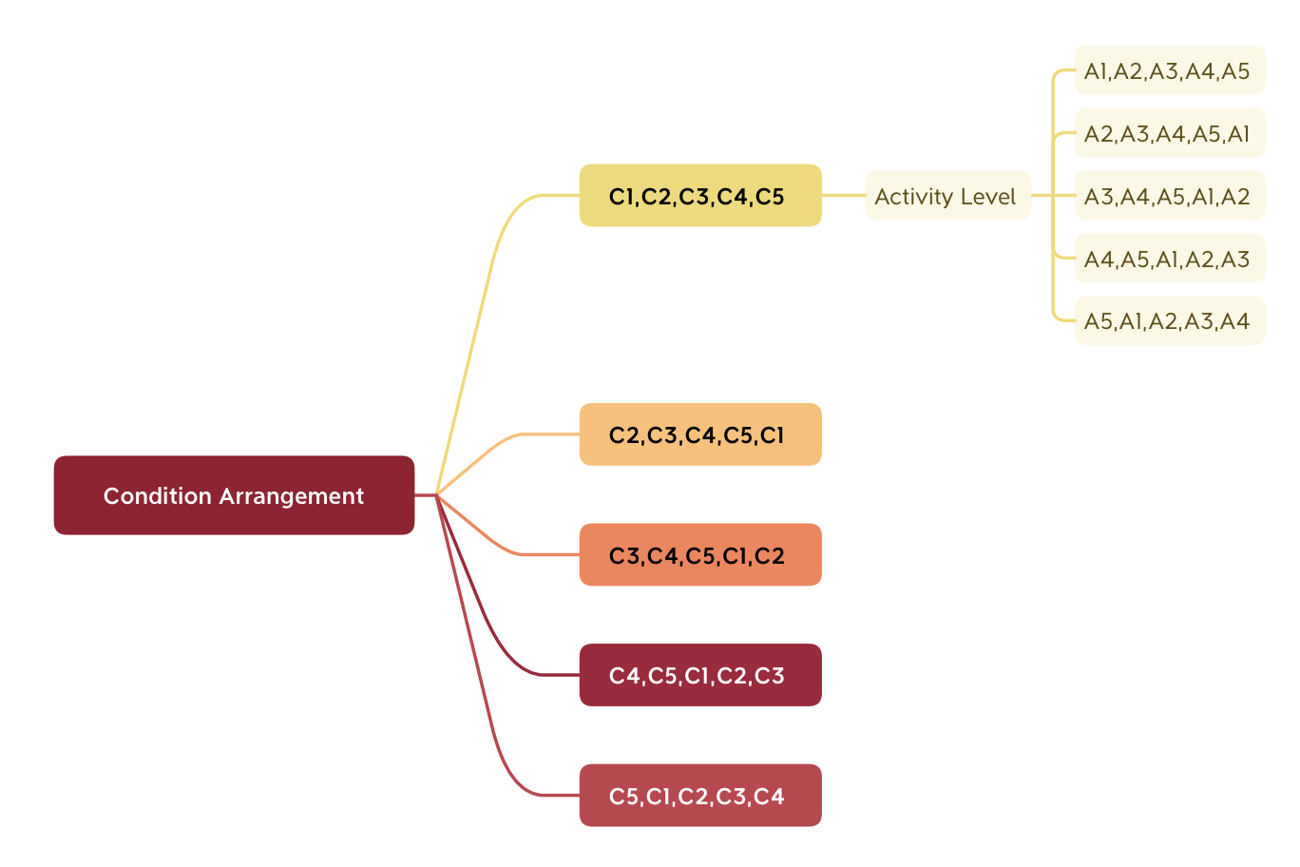
Example 1: Notification Channels for Wearable Ring

Slide 80
Example 1: Notification Channels for Wearable Ring
3.4: Arrange the overall design
3.5: Determine detailed arrangement for each participant
Each participant with 25 tests
(C1,C2,C3,C4,C5)
(C2,C3,C4,C5,C1)
(C3,C4,C5,C1,C2)
(C4,C5,C1,C2,C3)
(C5,C1,C2,C3,C4)
(A1,A2,A3,A4,A5)
(A2,A3,A4,A5,A1)
(A3,A4,A5,A1,A2)
(A4,A5,A1,A2,A3)
(A5,A1,A2,A3,A4)
5*5 Matrix:

Slide 81
Strong Assumption of Counter-Balancing
Counter-balancing Assumes symmetric transfer and linear increment
A-B transfer == B-A transfer
A-B transfer == B-C transfer

Slide 82
Strong Assumption of Counter-Balancing
Counter-balancing Assumes symmetric transfer and linear increment
A-B transfer == B-A transfer
A-B transfer == B-C transfer
If asymmetric transfer and non-linear increment
Have to use Between-subjects design
Also, some factors have to be between-subject
Age, Gender, etc.

Slide 83
Strategies to Reduce Conditions
Too many conditions: In experiment design, one major problem we often face is there are many possible relevant factors.
How to pick the most important/interesting factors to test?
Run a few independent variables at a time
If strong effect:
Include this variable
Else:
Set it as control variable

Slide 84
Strategies to Reduce Conditions
Too many conditions: In experiment design, one major problem we often face is there are many possible relevant factors.
How to pick the most important/interesting factors to test?
Run a few independent variables at a time
Not all within-subject IVs need to be counter-balanced
If we don’t really care about the difference among different levels , then no need to use counter-balancing.

Slide 86
Pipeline of Arranging Conditions
3.1: List all Independent Variables and their levels
3.2: Decide counter-balancing strategy for each variable (for within-subject design)
3.3: Determine the minimum No. of participants
3.4: Arrange the overall design
3.5: Determine detailed arrangement for each participant

Slide 87
STEP4
Decide Blocks & Trials
Presenter: LIANG Qihao, Group 4

Slide 88
What are Blocks and Trials
Trial
A single repetition of a single condition/cell
A number of trials are used to increase reliability
Block
An entire section of the experiment
Repeated to analyze learning

Slide 89
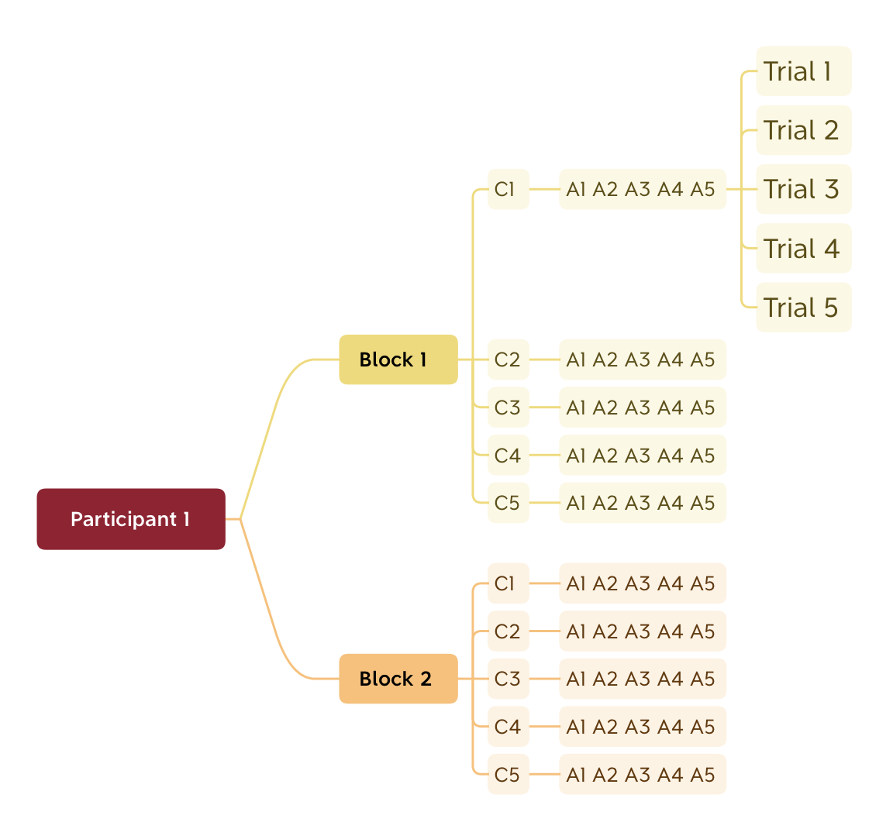
Trials in each block: same content, random orders
Block: same arrangement, repeated

Slide 90
How to determine the No. of Blocks and Trails?
Experiment Duration
Time Constraint and Fatigue
Typically within 1 hour
However, minus pre- and post-experiment interviews, only left with 45 minutes
In some cases, up to 2 hours
Enough Data for Significant Effect and Analysis

Slide 91




Pipeline of Deciding Blocks & Trials
4.1. estimate the time for each trial (typically at least 3 trials per condition)
4.2. estimate the time for each block
4.3. balance the trials and blocks so that the main part of the experiment is within 45 minutes
4.4. combine with the condition arrangement

Slide 92
STEP5: Set Instruction & Procedures
– What must be followed in conducting real experiments
Notes:
Instructions and Procedures are crucial to the real conduction of experiments.

Slide 93
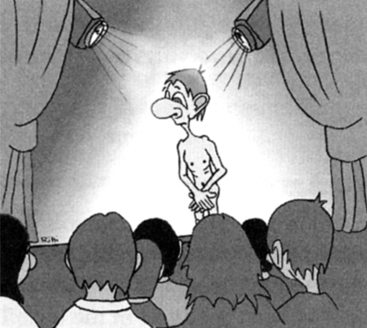
Golden Rule: To Treat Subjects with Maximum Respect
Subjects’ Standpoint
Researchers should:
Testing is a distressing experience
Pressure to perform
Feeling of inadequacy
Feeling like a fool in front of people…
Follow human subject protocols
Keep confidentiality
Keep anonymity
Respect user preference
…
Beware of legal requirements
Consent form
Ethical concerns
…
(Illustration from “Paper Prototyping” by Snyder)

Slide 94
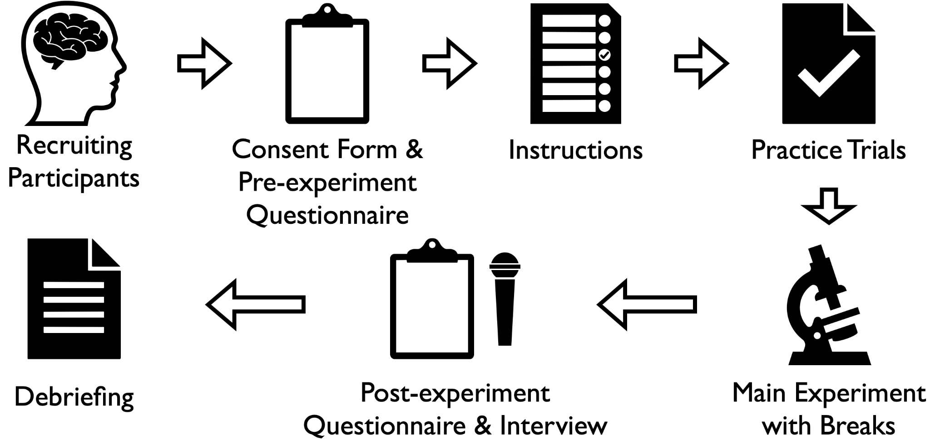
Expanding Step5: Set Instructions & Procedures
Before Experiments
During
Experiments
After Experiments

Slide 95


Step5.1: Recruiting Participants
Determine Target Users
Randomise User Characteristics
Do we need to focus on certain groups of users? What exact user groups do we want to focus on?
Prevent user characteristics from being biased against some factors (e.g. age, gender, etc)

Slide 96
Randomisation: Ideal and Practical
Ideal Randomisation
Practical Randomisation
randomises all possible participant characteristics;
enhances comprehensibility and dependability of experiments;
often virtually unachievable and majorly remains an ideal.
considers practicality & availability of partcipants
maximally randomise a group of participants available
is broadly utilised in existing HCI research
is problem-specific

Slide 97
Step5.1: Example A
Here follows an excerpt of participant description from a paper exploring pen-based mode switching.
“Fifteen adult volunteers were recruited from a university campus. They were graduate and undergraduate students, two female and thirteen male, 20 to 30 years old. They received $25 for their participation. None of these participants were involved in the preliminary experiment for determining the pressure threshold.” (Li et al., 2005)
Target Group:
Adult
University students
No involvement in preliminary experiment (a task-specific requirement)
Randomisation:
Both graduate and undergraduate students
2 female and 13 male
20-30 years old
Notes:
Ideal/Practical Randomisation -> Their difference
E.g. Univ Students from diff backgrounds
Depends on problem (text entry… for university some ok but others not necessary…);

Slide 98
Step5.1: Example B
“25 participants (9 female, 18 male) ranging from 20-35 years old (M=23.8, SD=3.1) volunteered for the study. The experiment was conducted in a well-lit gym close to the university with a constant (air-conditioned) temperature of 23°C. For walking and running tasks, we used a FreeMotion Reflex t 11.8 Treadmill.” (Roumen et al., 2015)
Target Group: Healthy people
Randomisation: 9 female and 18 male, 20-35 years old

Slide 99


Step5.2: Consent Form & Pre-Experiment Questionnaire
Protect Legal Rights of Both Sides
Help Understand Subject Portraits
By signing the form, participants concur with the terms & conditions listed in the form. The experiment is legally protected.
Understand the background information of participants, e.g. age, gender, occupation, etc.

Slide 100
Step5.2: Example A
Here follows an excerpt of participant description from a paper exploring pen-based mode switching.
“Fifteen adult volunteers were recruited from a university campus. They were graduate and undergraduate students, two female and thirteen male, 20 to 30 years old. They received $25 for their participation. None of these participants were involved in the preliminary experiment for determining the pressure threshold.” (Li et al., 2005)
Participant Background:
Adult & University students
No involvement in preliminary experiment (a task-specific requirement)
Both graduate and undergraduate students
2 female and 13 male
20-30 years old

Slide 101
Step5.2: Example B
“25 participants (9 female, 18 male) ranging from 20-35 years old (M=23.8, SD=3.1) volunteered for the study. The experiment was conducted in a well-lit gym close to the university with a constant (air-conditioned) temperature of 23°C. For walking and running tasks, we used a FreeMotion Reflex t 11.8 Treadmill.” (Roumen et al., 2015)
Participant Background
Healthy people, 9 female and 18 male, 20-35 years old

Slide 102
Step5.2: Thinking Question
What terms and items do we need to consider in designing consent forms?
https://pollev.com/szhao168
Notes:
Internal review board (managing ethical … concerns)
Templates … find online…

Slide 103
Step5.2: What is a Good Consent Form?
A good consent form should basically include:
Who you are.
What you are asking the participants to do.
What kind of data you will be collecting and how it will be used.
What rights the participant has.
If participants will be compensated.
The participant must explicitly say "yes" to the consent form.
Notes:
Internal review board (managing ethical … concerns)
Templates … find online…

Slide 104
Step5.2: An Example of Consent From
Who you are.
We are students in the Human-Computer Interaction course. For our first coursework we are studying how students at the University of Edinburgh use calendaring systems such as paper calendars, Google Calendar, and Office 365 Calendar.
In this survey we are investigating how people use their online calendars so that we can better understand their calendar-related needs and choices. We will ask you for some information about yourself, about the way in which you use computers and the internet, about the tools you use to manage your timetable and other events.
Completing the survey will take about 10 minutes. You can interrupt the survey at any time and return to finish it later. All the data that you provide will be stored on [list your survey provider] and user-level access will be restricted to our group. Questions marked with a red star are mandatory - you will need to answer them in order to complete the survey.
This project has undergone ethical screening in accordance with the University of Edinburgh School of Informatics ethics process (RT1432). You will be paid $20 on your successful completion of this experiment.
Do you agree to take part in this study, and do you agree that I can use your data for my HCI student project.
Yes / No
(Adapted from HCI: Consent Example from School of Informatics, the University of Edinburgh)
What you are asking your participants to do.
What rights participants have.
What data you will be collecting and how it will be used.
What you are asking your participants to do.
Whether participants will be compensated.
Participants must explicitly say YES to this form.
Notes:
Internal review board (managing ethical … concerns)
Templates … find online…

Slide 105
Step5.3&5.4: Instructions & Practice Trials
What are “Instructions”?
Directions, orders or rules recommended for guiding users to finish experiments swimmingly.
What are “trials”?
Technically, a trial is a single repetition of a single condition, where:
Trials in a single condition should be equivalent, fair and unbiased
At least three trials in a single condition are needed to increase reliability
Metaphorically speaking, trails are “pilots studies” or “warm-up sessions” of experiments.
We cannot risk changing experimental details once they are initiated.

Slide 106
Step5.3&5.4: Thinking question:
Under what circumstances do we need practice trials? Are they always necessary or not?
https://pollev.com/szhao168

Slide 107
Step5.3&5.4: Thinking question:
What are the advantages of conducting practice trails?
https://pollev.com/szhao168

Slide 108
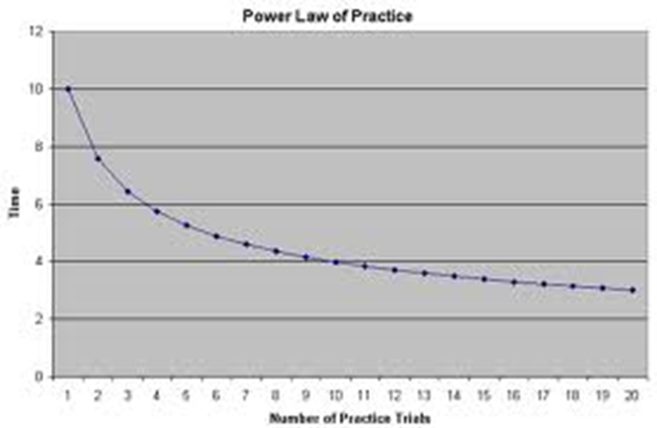
Step5.3&5.4: Example
EarPod
New technique which has never been tried using by anyone.
iPod
Existing technique that has been broadly utilised
Notes:
Practice trials: compare existing//new
EarPod: lower part of learning curve
iPod:
Not fair if no trials, but need narrow the gap…

Slide 109
Step5.3&5.4: Thinking about: our opinions
Under what circumstances do we need practice trials? Are they always necessary or not?
Practice trials are always necessary, especially:
when some prerequisites are needed for users to finish the experiment (new conditions);
when we compare existing and new methods
What are the advantages of conducting practice trails?
“Economicalise” real experiments: They reduce the “learning” that participants undergo during experiment.
Optimise real experiments: Testing the feasibility of experimental processes in advance, and making adjustments if necessary.
Notes:
Some are always needed for all experiments more or less -> need to familiarise partici with procedures… -> when new conditions especially

Slide 110


Step5.5: Make Experiments with Breaks
During Experiments:
Stay Neutral
Never Disclose Preferences
Do not bias the participants’ decisions, judgements, operations and so forth during experiments
Never indicate your personal preferences toward participants’ decisions, actions and so forth.

Slide 111
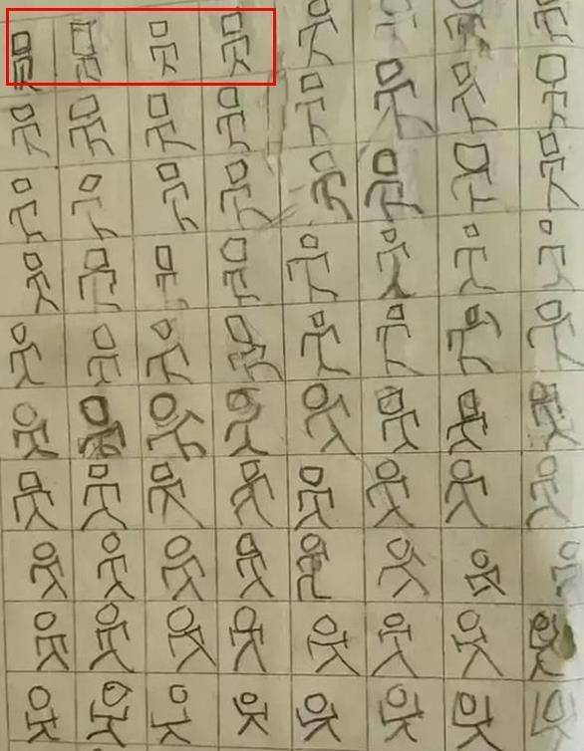
Step5.5: Make Experiments with Breaks
An Interesting Example:
Imagine you are required to write a Chinese character a hundred times repeatedly. You will finally find you can no longer recognise what you are writing XD.
So, breaks are really important in addition to the experiment itself!
(Picture from Sohu)

Slide 112
Step5.5: Make Experiments with Breaks
Long and enduring engagement in experiments can be tedious and exhausts participants.
Influence participants’ focus, judgement and performance
Influence the effectiveness and reliability of experiments

Slide 113
Step5.5: Examples in Academic Papers
“Procedure
The experiment was divided into five sections, one for each ring. Participants were asked to wear the ring on either their middle or ring finger of their dominant hand, depending on which finger provided the better fit. During each section, participants underwent trials for all five levels of physical activity. After a new physical activity was started, we allowed 30 seconds of warm-up time before starting a trial. Each trial lasted for up to 50 seconds, during which a notification would randomly occur. Participants were allowed to take breaks before or after completing an activity or when switching rings.”
(Roumen et al., 2015)
“Procedure The experiment included a training phase for the baseline tasks, five experimental sessions with one session for each technique, and a post-study questionnaire. The experiment took about 80 minutes in total. A 5x5 Latin Square was used to counterbalance the order of the techniques. Each session was divided into two parts. The first part involved learning to use a mode-switching technique and extensive practice. The second part was the experimental phase in which a participant was given 9 blocks of trials. The first block was a baseline task and then a compound task, alternating until the ninth block ended with a baseline task. A participant could take a break between blocks.” (Li et al., 2005)

Slide 114

Step5.6: Post-experiment Questionnaire & Interviews
Interesting Findings & Observations
Participants’ Comments on the Experiment
You could have observed some interesting points of participants during experiments. You may explore them afterward.
You could also solicit participants’ opinions on the experiment, which can also be helpful to analysing the results.

Slide 115
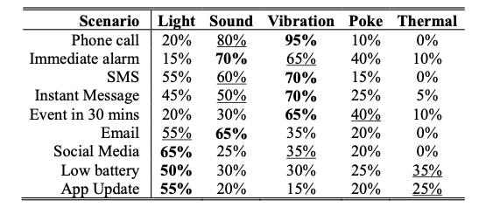
Step5.6: Examples in Academic Papers
“Table 3 shows the result of the post-experimental survey. Based on the performance results, We found that vibration, sound, and poke all have faster reaction time and are not affected by levels of physical activity.” “We also collected user preferences via the post-experiment survey that mapped channels to notification scenarios.“
(Roumen et al., 2015)
“Procedure The experiment included a training phase for the baseline tasks, five experimental sessions with one session for each technique, and a post-study questionnaire. The experiment took about 80 minutes in total. A 5x5 Latin Square was used to counterbalance the order of the techniques. Each session was divided into two parts. The first part involved learning to use a mode-switching technique and extensive practice. The second part was the experimental phase in which a participant was given 9 blocks of trials. The first block was a baseline task and then a compound task, alternating until the ninth block ended with a baseline task. A participant could take a break between blocks.” (Li et al., 2005)

Slide 116
Step5.7: Debriefing
Debriefing: Inform participants of your objectives of doing these experiments.
Ask for these opinions/views on your objectives.
Clarify their concerns/doubts regarding the anything related to the experiments.

Slide 117
Summary of Quantitative Experiment Design

Slide 118
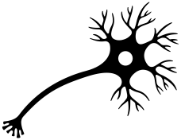
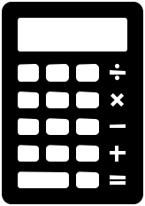



The Five-Step Paradigm of Experiment Design
1. Define Research Question
2. Determine Variables
3. Arrange Conditions
4. Decide Blocks and Trials
5. Set Instructions and Procedures

Slide 119




Expanding Step 1: Define Research Question
1.1. Start with a general question
1.2. Define the target population
1.3. Define task(s)
1.4. Define measure(s)
1.5. Define factor(s)

Slide 120
Expanding Step 2: Determine Variables
Task Type & Factor
Independent Variables
Measures
Dependent Variables
Control/Random Variables
Everything Else
Spot or Removing Confounding Variables

Slide 121



Expanding Step 3: Arrange Conditions
3.1. List all Independent Variables and their levels
3.2. Decide counter-balancing strategy for each variable
3.3. Determine the minimum No. of participants
3.4. Arrange the overall design
5. Determine detailed arrangement for each participant

Slide 122
Expanding Step 4: Decide Blocks and Trials
4.1. estimate the time for each trial (typically at least 3 trials per condition)
4.2. estimate the time for each block
4.3. balance the trials and blocks so that the main part of the experiment is within 45 minutes
4.4. combine with the condition arrangement

Slide 123
Expanding Step 5: Set Instructions and Procedures

Slide 124
References
Li, Y., Hinckley, K., Guan, Z., & Landay, J. A. (2005). Experimental analysis of mode switching techniques in pen-based user interfaces. Proceedings of the SIGCHI Conference on Human Factors in Computing Systems, 461–470. https://doi.org/10.1145/1054972.1055036
Roumen, T., Perrault, S. T., & Zhao, S. (2015). NotiRing: A Comparative Study of Notification Channels for Wearable Interactive Rings. Proceedings of the 33rd Annual ACM Conference on Human Factors in Computing Systems, 2497–2500. https://doi.org/10.1145/2702123.2702350

